Slide 1
Number Systems & Operations
Part III

Slide 2
Contents
1’s and 2’s Compliment
The Sign Bit
Signed Numbers
Decimal Value of Signed Numbers
Range of Signed Integer Numbers

Slide 3
1’s and 2’s Complements
They are important since they permit the presentation of negative numbers.
The method of 2’s complement arithmetic is commonly used in computers to handle negative numbers.

Slide 4
Finding the 1’s complement
Very simple: change each bit in a number to get the 1’s complement
Example: find 1’s complement of 11100101₂
Binary | 1 | 1 | 1 | 0 | 0 | 1 | 0 | 1
 | ↓ | ↓ | ↓ | ↓ | ↓ | ↓ | ↓ | ↓
1’s Complement | 0 | 0 | 0 | 1 | 1 | 0 | 1 | 0

Slide 5
Finding the 2’s Complement
Add 1 to the 1’s complement to get the 2’s complement.
Example:
 |  |  | ₊₁
10110010₂ | → | 01001101₂ | → | 01001110₂

Slide 6
Finding the 2’s Complement
An alternative method:
Start at the right with the LSB and write the bits as they are up to and including the first 1.
Take the 1’s complement of the remaining bits.

Slide 7
Contents
1’s and 2’s Compliment
The Sign Bit
Signed Numbers
Decimal Value of Signed Numbers
Range of Signed Integer Numbers

Slide 8
Contents
1’s and 2’s Compliment
The Sign Bit
Signed Numbers
Decimal Value of Signed Numbers
Range of Signed Integer Numbers

Slide 9
Contents
1’s and 2’s Compliment
The Sign Bit
Signed Numbers
Decimal Value of Signed Numbers
Range of Signed Integer Numbers

Slide 10
Contents
1’s and 2’s Compliment
The Sign Bit
Signed Numbers
Decimal Value of Signed Numbers
Range of Signed Integer Numbers

Slide 11
Basic Operations
Basic of binary arithmetic
Binary addition
Binary subtraction
Binary multiplication
Binary division

Slide 12
Contents
Binary Arithmetic
Binary addition
Binary subtraction
Binary multiplication
Binary division

Slide 13

FOUR (4) Basic Rules
The four basic rules for adding digits are as follows:
$0+0=0$ → sum of $0$ with a carry of $0$
$0+1=1$ → sum of $1$ with a carry of $0$
$1+0=1$ → sum of $1$ with a carry of $0$
$1+1=10$ → sum of $0$ with a carry of $1$

Slide 14
Example
Carry | 1 | 1
 |  | 1 | 1
 |  | 1 | 1
Sum | 1 | 1 | 0
Carry | 0 | 0
 | 1 | 0 | 0
 |  | 1 | 0
Sum | 1 | 1 | 0
Carry | 1 | 1 | 1
 |  | 1 | 1 | 1
 |  |  | 1 | 1
Sum | 1 | 0 | 1 | 0
Carry | 1 | 0 | 0
 |  | 1 | 1 | 0
 |  | 1 | 0 | 0
Sum | 1 | 0 | 1 | 0

Slide 15
Contents
Binary Arithmetic
Binary addition
Binary subtraction
Binary multiplication
Binary division

Slide 16

FOUR (4) Basic Rules
The four basic rules for subtracting digits are as follows:
$0−0=0$ → difference of $0$ with a borrow of $0$
$1−1=0$ → difference of $0$ with a borrow of $0$
$1−0=1$ → difference of $1$ with a borrow of $0$
$10−1=1 ;0−1$ → difference of $1$ with a borrow of $1$

Slide 17
Example
 | 1 | 1
 | 0 | 1
Borrow | 0
Difference | 1 | 0
 | 1 | 1
 | 1 | 0
Borrow | 0
Difference | 0 | 1
 | 1 | 0 | 1
 |  | 1 | 1
Borrow | 1 | 0
Difference | 0 | 1 | 0

Slide 18
Contents
Binary Arithmetic
Binary addition
Binary subtraction
Binary multiplication
Binary division

Slide 19
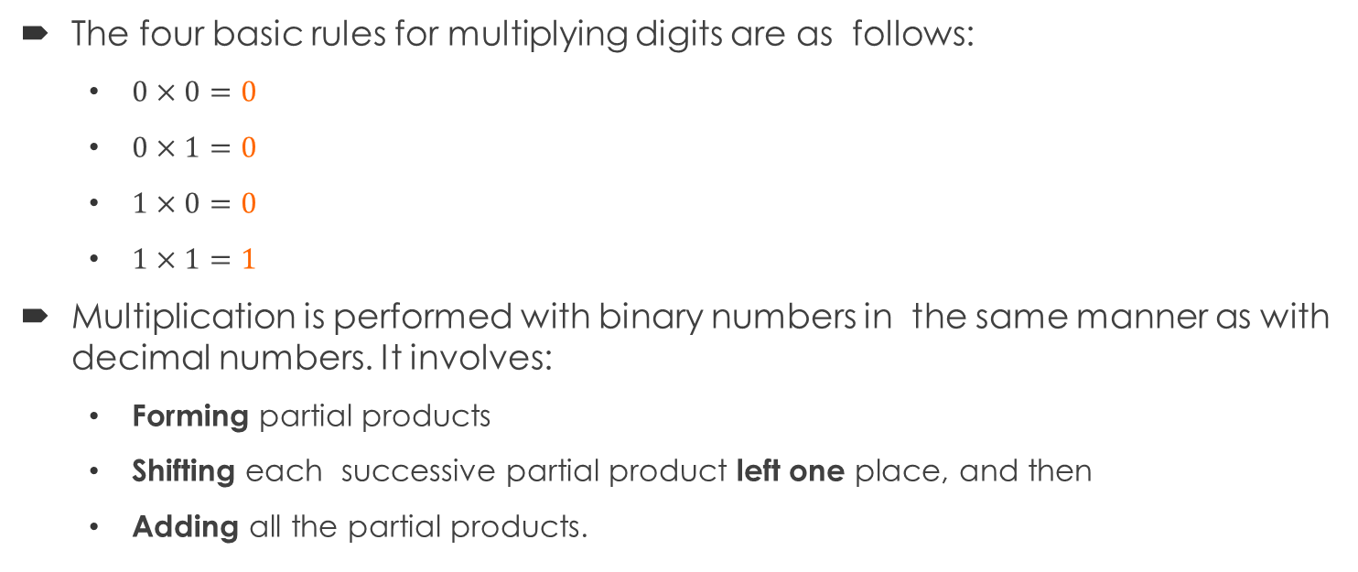
FOUR (4) Basic Rules
The four basic rules for multiplying digits are as follows:
$0×0=0$
$0×1=0$
$1×0=0$
$1×1=1$
Multiplication is performed with binary numbers in the same manner as with decimal numbers. It involves:
Forming partial products
Shifting each successive partial product leftone place, and then
Adding all the partial products.

Slide 20
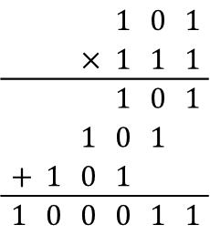
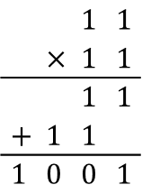
Example
 |  | $$1$$ | $$1$$
 | $$×$$ | $$1$$ | $$1$$
 |  | $$1$$ | $$1$$
$$+$$ | $$1$$ | $$1$$
$$1$$ | $$0$$ | $$0$$ | $$1$$
 |  |  | $$1$$ | $$0$$ | $$1$$
 |  | $$×$$ | $$1$$ | $$1$$ | $$1$$
 |  |  | $$1$$ | $$0$$ | $$1$$
 |  | $$1$$ | $$0$$ | $$1$$
$$+$$ | $$1$$ | $$0$$ | $$1$$
$$1$$ | $$0$$ | $$0$$ | $$0$$ | $$1$$ | $$1$$

Slide 21
Contents
Binary Arithmetic
Binary addition
Binary subtraction
Binary multiplication
Binary division

Slide 22
Technique
Division in binary follows the same procedure as division in decimal.
1 | 0 | 1 | 1 | 0 | 1 | 1
 |  | 1 | 0
 |  | 0 | 1 | 0
 |  |  | 1 | 0
 |  |  | 0 | 0
1 | 1 | 1 | 1 | 0 | 1 | 0
 |  | 1 | 1
 |  | 0 | 0 | 0

Slide 23
End of Part II

